Slide 2
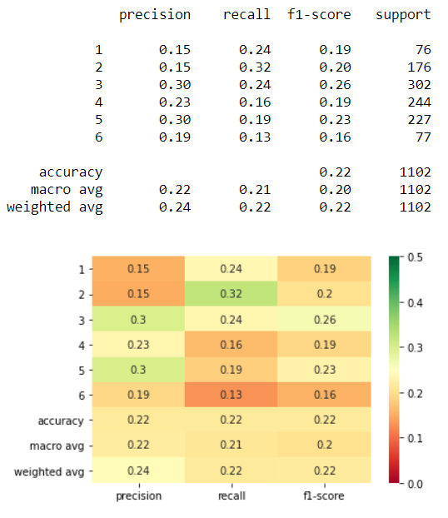
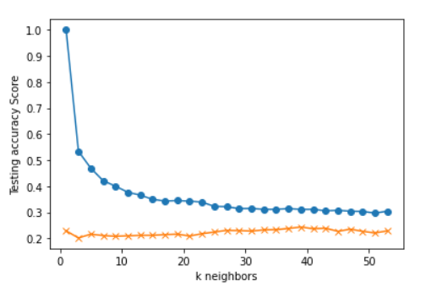
Criteria:
S&P 500 Day(s) Forward Return: 1
Number of Return Percentile Bins: 6
1: Lowest 10% Returns Below -1.30%
2: 10% to 30% Between -1.30% and -0.32%
3: 30% to 50% Between -0.32% and 0.06%
4: 50% to 70% Between 0.06% and 0.46%
5: 70% to 90% Between 0.46% and 1.27%
6: Highest 10% Returns Above 1.27%
X-Feature Inputs: K Neighbors: 39
12WMA%12EMA
12WMA%26EMA
12EMA%26EMA
50SMA%100SMA
50SMA%200SMA
100SMA%200SMA
RSI
SP500 corr 6Mo-3Mo % Ret
Div/10Yr-2Yr
SP500%12WMA
SP500%12EMA
SP500%26EMA
SP500%50SMA
SP500%100SMA
SP500%200SMA
SP500%3Upper
SP500%2Upper
SP500%Middle20Day
SP500%2Lower
SP500%3Lower

Slide 3
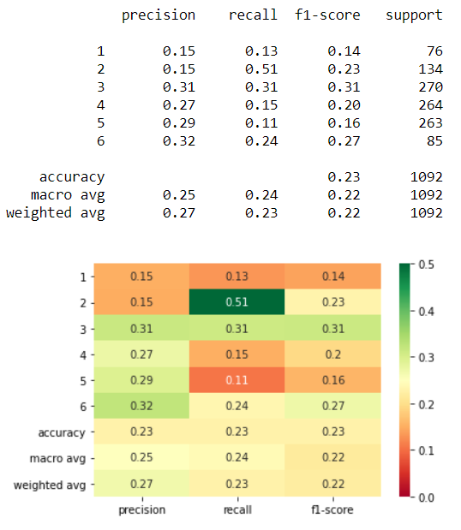
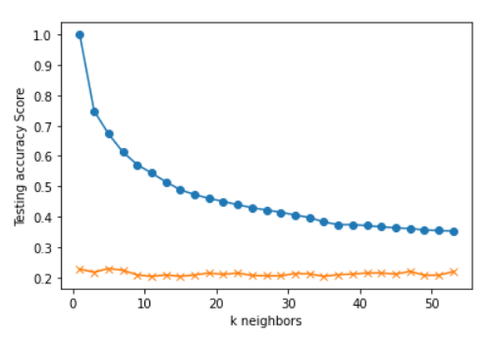
Criteria:
S&P 500 Day(s) Forward Return: 10
Number of Return Percentile Bins: 6
1: Lowest 10% Returns Below -3.69%
2: 10% to 30% Between -3.69% and -0.88%
3: 30% to 50% Between -0.88% and 0.54%
4: 50% to 70% Between 0.54% and 1.73%
5: 70% to 90% Between 1.73% and 3.73%
6: Highest 10% Returns Above 3.73%
X-Feature Inputs: K Neighbors: 5
12WMA%12EMA
12WMA%26EMA
12EMA%26EMA
50SMA%100SMA
50SMA%200SMA
100SMA%200SMA
RSI
SP500 corr 6Mo-3Mo % Ret
Div/10Yr-2Yr
SP500%12WMA
SP500%12EMA
SP500%26EMA
SP500%50SMA
SP500%100SMA
SP500%200SMA
SP500%3Upper
SP500%2Upper
SP500%Middle20Day
SP500%2Lower
SP500%3Lower

Slide 4
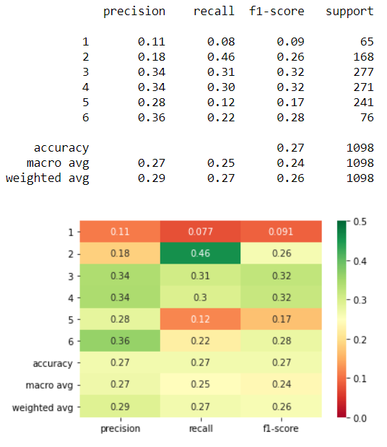
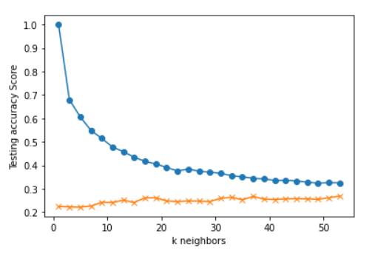
Criteria:
S&P 500 Day(s) Forward Return: 5
Number of Return Percentile Bins: 6
1: Lowest 10% Returns Below -2.78%
2: 10% to 30% Between -2.78% and -0.70%
3: 30% to 50% Between -0.70% and 0.29%
4: 50% to 70% Between 0.29% and 1.19%
5: 70% to 90% Between 1.19% and 2.70%
6: Highest 10% Returns Above 2.70%
X-Feature Inputs: K Neighbors: 37
12WMA%12EMA
12WMA%26EMA
12EMA%26EMA
50SMA%100SMA
50SMA%200SMA
100SMA%200SMA
RSI
SP500 corr 6Mo-3Mo % Ret
Div/10Yr-2Yr
SP500%12WMA
SP500%12EMA
SP500%26EMA
SP500%50SMA
SP500%100SMA
SP500%200SMA
SP500%3Upper
SP500%2Upper
SP500%Middle20Day
SP500%2Lower
SP500%3Lower

Slide 5
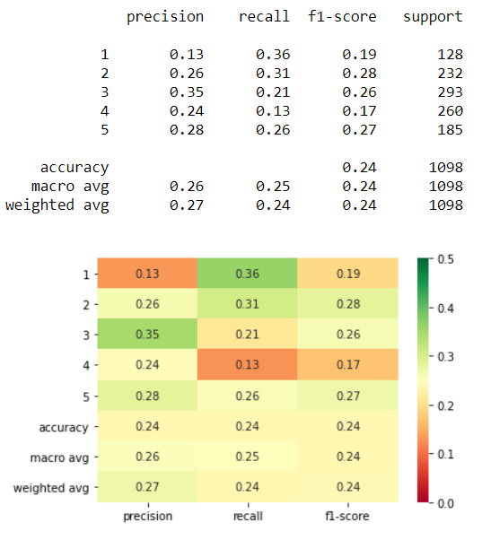
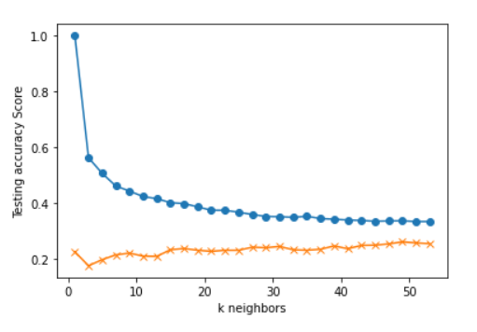
Criteria:
S&P 500 Day(s) Forward Return: 5
Number of Return Percentile Bins: 5
1: Lowest 20% Returns Below -1.47%
2: 20% to 40% Between -1.47% and -0.14%
3: 40% to 60% Between -0.14% and 0.72%
4: 60% to 80% Between 0.72% and 1.74%
5: Highest 20% Returns Above 1.74%
X-Feature Inputs: K Neighbors: 17
12WMA%12EMA
12WMA%26EMA
12EMA%26EMA
50SMA%100SMA
50SMA%200SMA
100SMA%200SMA
RSI
SP500 corr 6Mo-3Mo % Ret
Div/10Yr-2Yr
SP500%12WMA
SP500%12EMA
SP500%26EMA
SP500%50SMA
SP500%100SMA
SP500%200SMA
SP500%3Upper
SP500%2Upper
SP500%Middle20Day
SP500%2Lower
SP500%3Lower

Slide 6
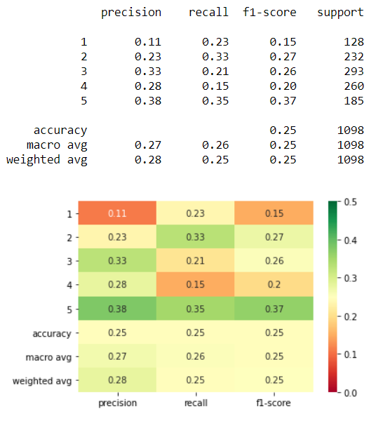
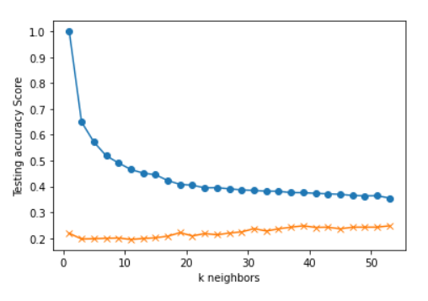
Criteria:
S&P 500 Day(s) Forward Return: 5
Number of Return Percentile Bins: 5
1: Lowest 20% Returns Below -1.47%
2: 20% to 40% Between -1.47% and -0.14%
3: 40% to 60% Between -0.14% and 0.72%
4: 60% to 80% Between 0.72% and 1.74%
5: Highest 20% Returns Above 1.74%
X-Feature Inputs: K Neighbors: 39
12WMA%12EMA
12WMA%26EMA
12EMA%26EMA
50SMA%100SMA
50SMA%200SMA
100SMA%200SMA
RSI
SP500 corr 6Mo-3Mo % Ret
Div/10Yr-2Yr
SP500%12WMA
SP500%12EMA
SP500%26EMA
SP500%50SMA
SP500%100SMA
SP500%200SMA
SP500%3Upper
SP500%2Upper
SP500%Middle20Day
SP500%2Lower
SP500%3Lower

Slide 7
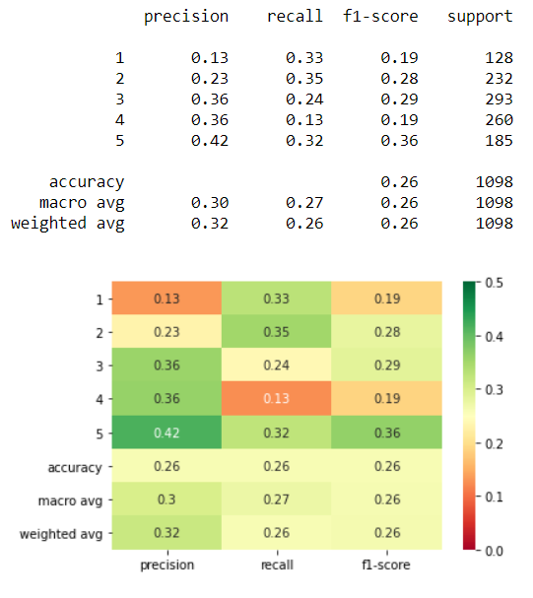
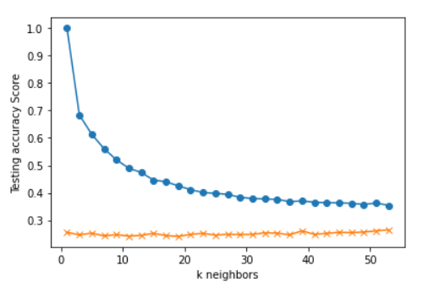
Criteria:
S&P 500 Day(s) Forward Return: 5
Number of Return Percentile Bins: 5
1: Lowest 20% Returns Below -1.47%
2: 20% to 40% Between -1.47% and -0.14%
3: 40% to 60% Between -0.14% and 0.72%
4: 60% to 80% Between 0.72% and 1.74%
5: Highest 20% Returns Above 1.74%
X-Feature Inputs: K Neighbors: 39
12WMA%12EMA
12WMA%26EMA
12EMA%26EMA
50SMA%100SMA
50SMA%200SMA
100SMA%200SMA
RSI
SP500 corr 6Mo-3Mo % Ret
Div/10Yr-2Yr
SP500%12WMA
SP500%12EMA
SP500%26EMA
SP500%50SMA
SP500%100SMA
SP500%200SMA
SP500%3Upper
SP500%2Upper
SP500%Middle20Day
SP500%2Lower
SP500%3Lower

Slide 8
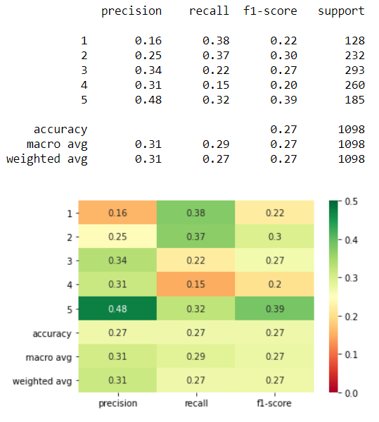
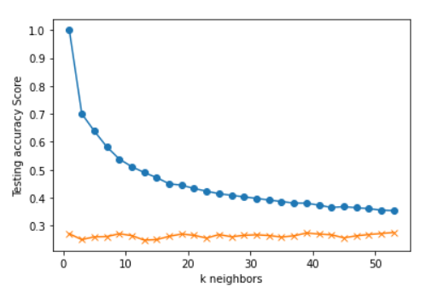
Criteria:
S&P 500 Day(s) Forward Return: 5
Number of Return Percentile Bins: 5
1: Lowest 20% Returns Below -1.47%
2: 20% to 40% Between -1.47% and -0.14%
3: 40% to 60% Between -0.14% and 0.72%
4: 60% to 80% Between 0.72% and 1.74%
5: Highest 20% Returns Above 1.74%
X-Feature Inputs: K Neighbors: 9
12WMA%12EMA
12WMA%26EMA
12EMA%26EMA
50SMA%100SMA
50SMA%200SMA
100SMA%200SMA
RSI
SP500 corr 6Mo-3Mo % Ret
Div/10Yr-2Yr
SP500%12WMA
SP500%12EMA
SP500%26EMA
SP500%50SMA
SP500%100SMA
SP500%200SMA
SP500%3Upper
SP500%2Upper
SP500%Middle20Day
SP500%2Lower
SP500%3Lower

Slide 9
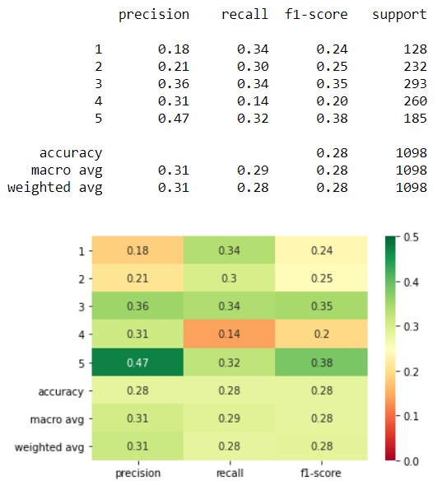
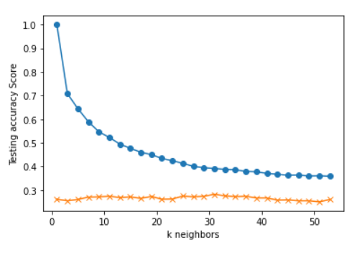
Criteria:
S&P 500 Day(s) Forward Return: 5
Number of Return Percentile Bins: 5
1: Lowest 20% Returns Below -1.47%
2: 20% to 40% Between -1.47% and -0.14%
3: 40% to 60% Between -0.14% and 0.72%
4: 60% to 80% Between 0.72% and 1.74%
5: Highest 20% Returns Above 1.74%
X-Feature Inputs: K Neighbors: 31
12WMA%12EMA
12WMA%26EMA
12EMA%26EMA
50SMA%100SMA
50SMA%200SMA
100SMA%200SMA
RSI
SP500 corr 6Mo-3Mo % Ret
Div/10Yr-2Yr
SP500%12WMA
SP500%12EMA
SP500%26EMA
SP500%50SMA
SP500%100SMA
SP500%200SMA
SP500%3Upper
SP500%2Upper
SP500%Middle20Day
SP500%2Lower
SP500%3Lower

Slide 10
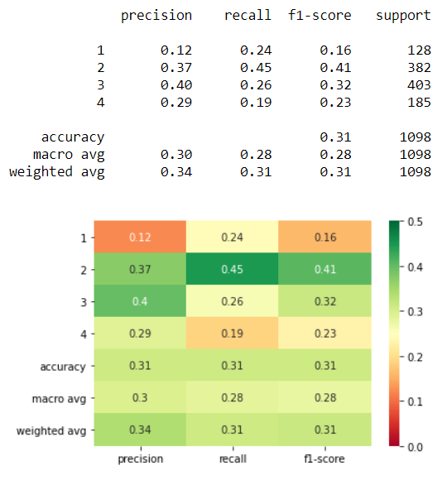
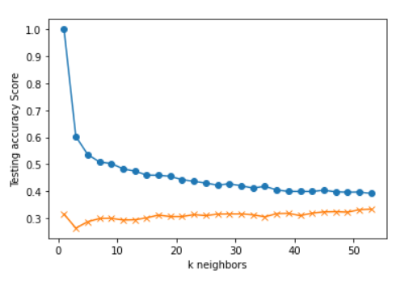
Criteria:
S&P 500 Day(s) Forward Return: 5
Number of Return Percentile Bins: 4
1: Lowest 20% Returns Below -1.47%
2: 20% to 50% Between -1.47% and 0.29%
3: 50% to 80% Between 0.29% and 1.74%
4: Highest 20% Returns Above 1.74%
X-Feature Inputs: K Neighbors: 17
12WMA%12EMA
12WMA%26EMA
12EMA%26EMA
50SMA%100SMA
50SMA%200SMA
100SMA%200SMA
RSI
SP500 corr 6Mo-3Mo % Ret
Div/10Yr-2Yr
SP500%12WMA
SP500%12EMA
SP500%26EMA
SP500%50SMA
SP500%100SMA
SP500%200SMA
SP500%3Upper
SP500%2Upper
SP500%Middle20Day
SP500%2Lower
SP500%3Lower

Slide 11
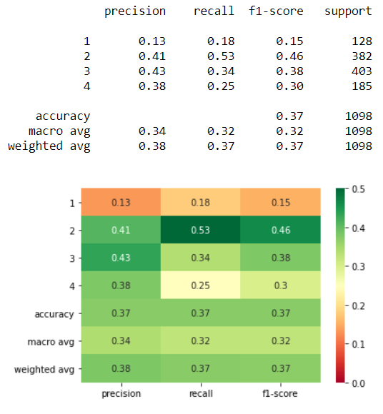
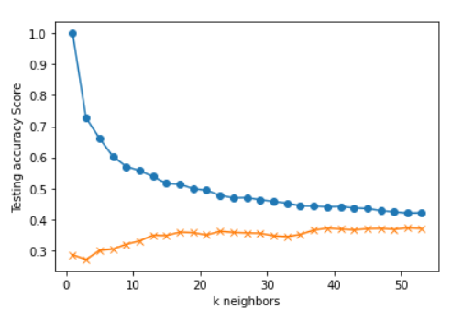
Criteria:
S&P 500 Day(s) Forward Return: 5
Number of Return Percentile Bins: 4
1: Lowest 20% Returns Below -1.47%
2: 20% to 50% Between -1.47% and 0.29%
3: 50% to 80% Between 0.29% and 1.74%
4: Highest 20% Returns Above 1.74%
X-Feature Inputs: K Neighbors: 39
12WMA%12EMA
12WMA%26EMA
12EMA%26EMA
50SMA%100SMA
50SMA%200SMA
100SMA%200SMA
RSI
SP500 corr 6Mo-3Mo % Ret
Div/10Yr-2Yr
SP500%12WMA
SP500%12EMA
SP500%26EMA
SP500%50SMA
SP500%100SMA
SP500%200SMA
SP500%3Upper
SP500%2Upper
SP500%Middle20Day
SP500%2Lower
SP500%3Lower

Slide 12
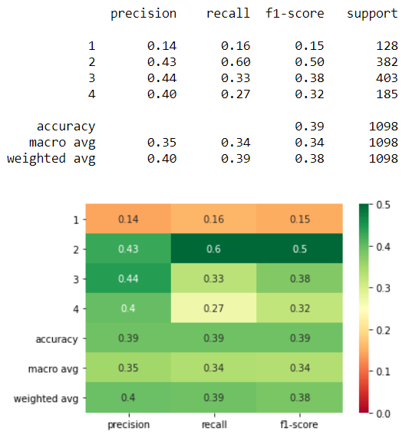
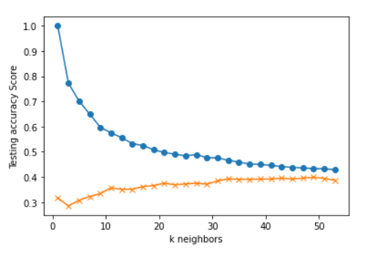
Criteria:
S&P 500 Day(s) Forward Return: 5
Number of Return Percentile Bins: 4
1: Lowest 20% Returns Below -1.47%
2: 20% to 50% Between -1.47% and 0.29%
3: 50% to 80% Between 0.29% and 1.74%
4: Highest 20% Returns Above 1.74%
X-Feature Inputs: K Neighbors: 33
12WMA%12EMA
12WMA%26EMA
12EMA%26EMA
50SMA%100SMA
50SMA%200SMA
100SMA%200SMA
RSI
SP500 corr 6Mo-3Mo % Ret
Div/10Yr-2Yr
SP500%12WMA
SP500%12EMA
SP500%26EMA
SP500%50SMA
SP500%100SMA
SP500%200SMA
SP500%3Upper
SP500%2Upper
SP500%Middle20Day
SP500%2Lower
SP500%3Lower

Slide 13
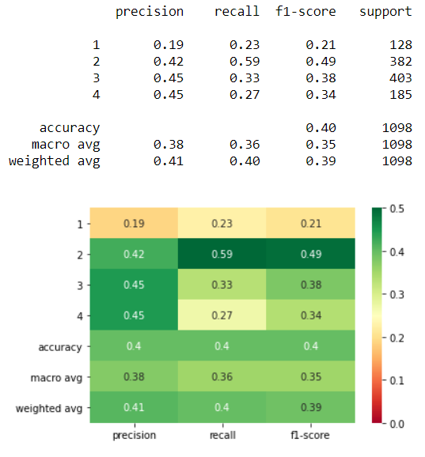
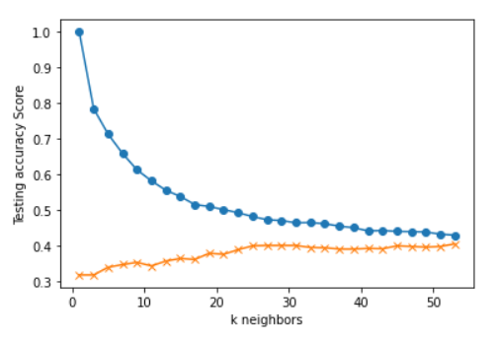
Criteria:
S&P 500 Day(s) Forward Return: 5
Number of Return Percentile Bins: 4
1: Lowest 20% Returns Below -1.47%
2: 20% to 50% Between -1.47% and 0.29%
3: 50% to 80% Between 0.29% and 1.74%
4: Highest 20% Returns Above 1.74%
X-Feature Inputs: K Neighbors: 27
12WMA%12EMA
12WMA%26EMA
12EMA%26EMA
50SMA%100SMA
50SMA%200SMA
100SMA%200SMA
RSI
SP500 corr 6Mo-3Mo % Ret
Div/10Yr-2Yr
SP500%12WMA
SP500%12EMA
SP500%26EMA
SP500%50SMA
SP500%100SMA
SP500%200SMA
SP500%3Upper
SP500%2Upper
SP500%Middle20Day
SP500%2Lower
SP500%3Lower

Slide 14
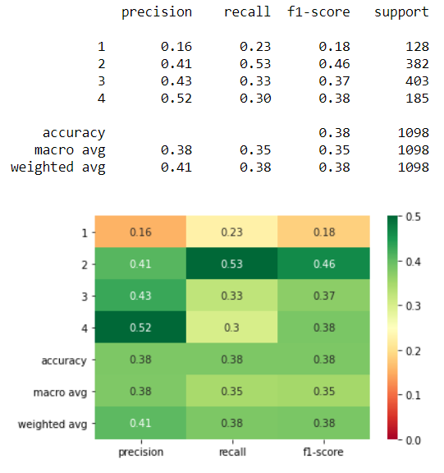
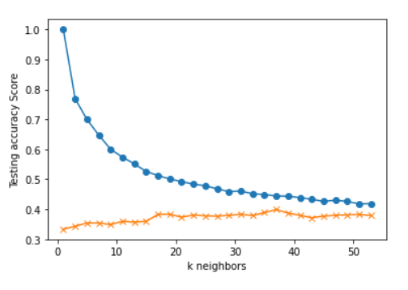
Criteria:
S&P 500 Day(s) Forward Return: 5
Number of Return Percentile Bins: 4
1: Lowest 20% Returns Below -1.47%
2: 20% to 50% Between -1.47% and 0.29%
3: 50% to 80% Between 0.29% and 1.74%
4: Highest 20% Returns Above 1.74%
X-Feature Inputs: K Neighbors: 37
12WMA%12EMA
12WMA%26EMA
12EMA%26EMA
50SMA%100SMA
50SMA%200SMA
100SMA%200SMA
RSI
SP500 corr 6Mo-3Mo % Ret
Div/10Yr-2Yr
SP500%12WMA
SP500%12EMA
SP500%26EMA
SP500%50SMA
SP500%100SMA
SP500%200SMA
SP500%3Upper
SP500%2Upper
SP500%Middle20Day
SP500%2Lower
SP500%3Lower

Slide 15
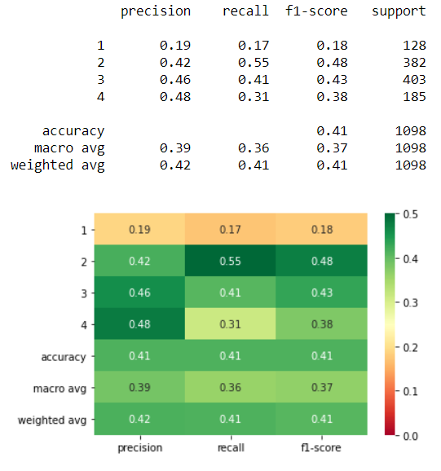
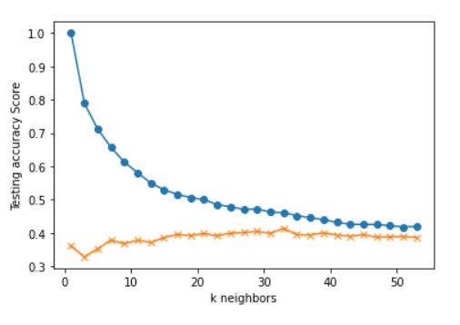
Criteria:
S&P 500 Day(s) Forward Return: 5
Number of Return Percentile Bins: 4
1: Lowest 20% Returns Below -1.47%
2: 20% to 50% Between -1.47% and 0.29%
3: 50% to 80% Between 0.29% and 1.74%
4: Highest 20% Returns Above 1.74%
X-Feature Inputs: K Neighbors: 33
12WMA%12EMA
12WMA%26EMA
12EMA%26EMA
50SMA%100SMA
50SMA%200SMA
100SMA%200SMA
RSI
SP500 corr 6Mo-3Mo % Ret
Div/10Yr-2Yr
SP500%12WMA
SP500%12EMA
SP500%26EMA
SP500%50SMA
SP500%100SMA
SP500%200SMA
SP500%3Upper
SP500%2Upper
SP500%Middle20Day
SP500%2Lower
SP500%3Lower

